Slide 1
Data Warehouse Systems
Sean Kang

Slide 2







Data Warehouse System
Source Area
Relational/non-relational
database
XML file
CSV file
Front-end Applications
Analysis Tools
Decision Support Tools
Target Data Warehouse
E
T
L

Slide 3
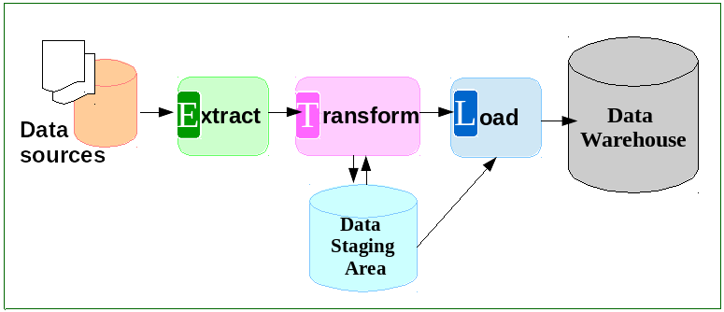
Extract-Transform-Load Process

Slide 4
Table Mapping Examples
One-to-one table mapping
Many-to-one table mapping
Source Table | Source Attribute | Target Table | Target Attribute | Selection Condition
Address | Address_key | Location | Location_id | Transform all the new addresses (Year>2000)
Source Table | Source Attribute | Target Table | Target Attribute | Selection Condition
Patient, Address | Address_key, Address_key | Person | Location_id | Transform all the current patients with their new addresses (Year>2000)
LEFT JOIN

Slide 5
Attribute Mapping Examples
One-to-one attribute mapping
Many-to-one attribute mapping
Source Table | Source Attribute | Target Table | Target Attribute | Selection Condition
Address | Address_key | Location | Location_id | Transform all the new addresses (Year>2000)
Source Table | Source Attribute | Target Table | Target Attribute | Selection Condition
Patient | Day_of_birth, Month_of_birth, Year_of_birth | Person | Date_of_birth | Transform all the current patients

Slide 6
Data Warehouse Features (Separation of Purposes)
A decision support database that is maintained separately from the organization’s operational database
Supports information processing by providing a solid platform of consolidated, historical data for analysis
Focuses on the modeling and analysis of data for decision makers, not on daily operations or transaction processing

Slide 7
Data Warehouse vs.
Operational DBMS
Major task of traditional relational DBMS:
OLTP (on-line transaction processing)
Day-to-day operations, such as purchasing, inventory, banking, manufacturing, payroll, registration, and accounting
Major task of data warehouse system:
OLAP (on-line analytical processing)
Data analysis and decision making

Slide 8
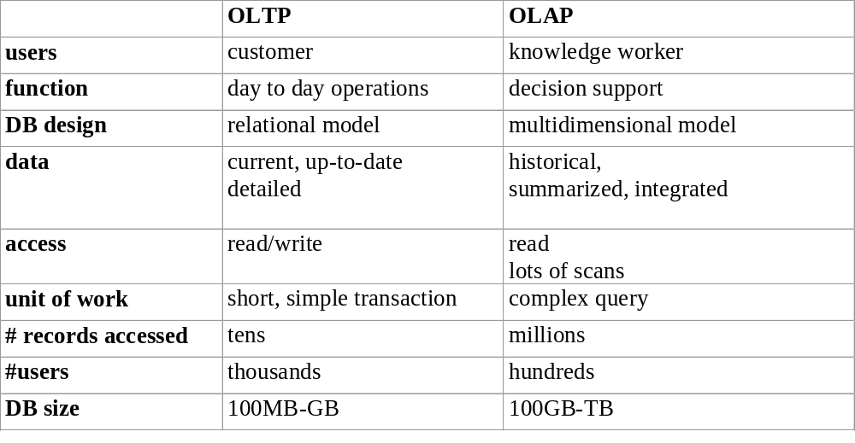
OLTP vs. OLAP

Slide 9
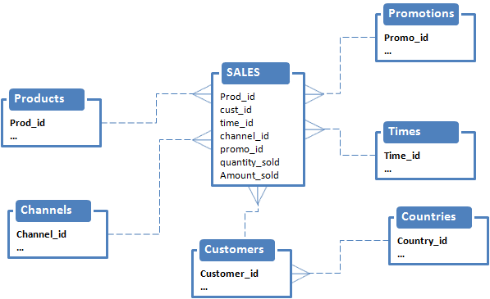
Multidimensional Data Model
Structures optimized for end-user queries that include:
Dimension table: contains descriptive attributes
Fact table: contains measurements of a business process and keys to each of the related dimension tables

Slide 10
Multidimensional Data Model
Star schema:
A fact table in the middle connected to a set of dimension tables
Snowflake schema (diagram on next slide)
Dimensions are split into more than one dimension tables
Star schema is a special case of the snowflake schema with a single level hierarchy
Fact constellations (diagram on next slide)
Multiple fact tables share dimension tables, viewed as a collection of stars, therefore called galaxy schema or fact constellation

Slide 11
Example of Star Schema
time
time_key
day
day_of_the_week
month
quarter
year
item
item_key
item_name
brand
type
supplier_type
Sales Fact Table
time_key
item_key
branch_key
branch
location
location_key
branch_key
branch_name
branch_type
location_key
street
city
province_or_street
country
units_sold
dollars_sold
avg_sales
Measures

Slide 12
Example of Snowflake Schema
time
item
time_key
day
day_of_the_week
month
quarter
year
item_key
item_name
brand
type
supplier_key
supplier
Sales Fact Table
supplier_key
supplier_type
time_key
item_key
branch_key
branch
location
location_key
location_key
street
city_key
branch_key
branch_name
branch_type
units_sold
city
dollars_sold
city_key
city
province_or_street
country
avg_sales
Measures

Slide 13
Example of Fact Constellation
time
time_key
day
day_of_the_week
month
quarter
year
item
Shipping Fact Table
item_key
item_name
brand
type
supplier_type
Sales Fact Table
time_key
time_key
item_key
shipper_key
item_key
branch_key
from_location
branch
location_key
location
to_location
branch_key
branch_name
branch_type
units_sold
location_key
street
city
province_or_street
country
dollars_cost
dollars_sold
units_shipped
avg_sales
shipper
Measures
shipper_key
shipper_name
location_key
shipper_type

Slide 14
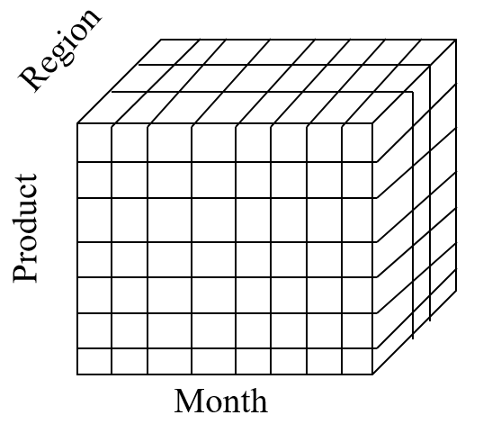
OLAP Using
Multidimensional Data
Enable users to access a wide variety of views of data for multidimensional analysis
Unlike traditional relational reports that represent data in two-dimensional row and column format, represent their aggregated data in a multi-dimensional structure called cube
Supports complicated queries involving facts to be measured across different dimensions
Example: Sales volume as a function of product, month, and region
Month

Slide 15

A Sample Data Cube
Date
Total annual sales
of TV in U.S.A.
1Qtr
2Qtr
3Qtr
4Qtr
sum
Product
TV
PC
U.S.A
VCR
sum
Canada
Country
Mexico
sum
All, All, All

Slide 16
Data Warehouse Usage
Information processing
Supports querying, basic statistical analysis, and reporting using tables, charts and graphs
Analytical processing
Multidimensional analysis of data warehouse data using OLAP operations
Data mining
Knowledge discovery from hidden patterns
Supports associations, constructing analytical models, performing classification and prediction, and presenting the mining results using visualization tools

Slide 17
Summary
Enterprises use data warehouses to accumulate data from multiple sources for data analysis and research
ETL process involves extracting data from source databases, transforming it into a form suitable for research and analysis, and loading it into a data warehouse
DBMS is tuned for OLTP: access methods, indexing, concurrency control, recovery
Data warehouse is tuned for OLAP: complex OLAP queries, multidimensional view, consolidation

Slide 18
Case Study Example: Transportation
Your Trip to NYC and back
One or More Stop-overs
  Each Flight contains
    Aircraft Tail ID, Departure, Destination, Planned Start time, Planned End Time,
    Aircraft Crew
    Aircraft Maintenance and Operations Status
    Flight Path, Runway used on take off, landing,
    Capacity at take off, Capacity ramp-up from 60 days
  Your Reservation
    Passenger Name, age, gender, contact info, purchase date, purchase source
    Number of days before departure
    Class level, mileage or reward accumulation

Slide 19
Tables
How many Fact Tables Involved in this Case Study
Multi-level Fact Tables
  Aircraft Flight
  Passenger Reservation
  Aircraft
How many Dimension Tables Involved
  Country, City, Airport
  Aircraft, Fuel
  Currency, Reward Points
  Timezone, Country-code,
  Passenger Type, Seat-Class,

Slide 20
Analysis Questions
How often do passengers upgrade? (is there sufficient data)
How % of customers earn and redeem their rewards within a year? (is there sufficient data)
Do they respond to fare promotions? (does the reservation data contain promotion codes)
Do customer take flights with overnight stop-over?
What proportion of the flight contains platinum passengers?
How many days before departure did most passengers reserve their tickets?
How many seats were empty on the flight?
Was the flight used as a multi-leg of a journey ?

Slide 21
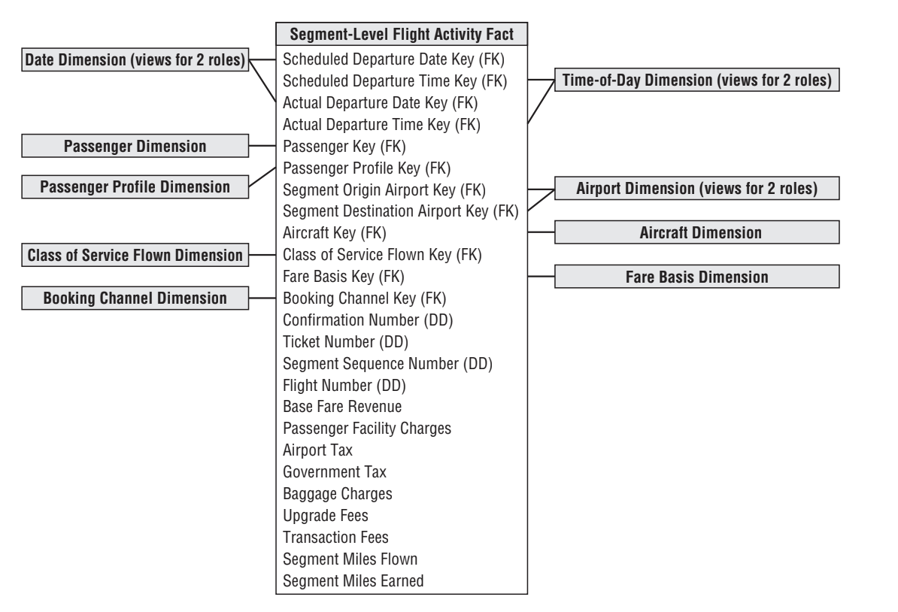
Sample Table

